Slide 1
From Recognition to Cognition: Visual Commonsense Reasoning
commonsense benchmark & multimodal reasoning
(2019 CVPR)
Notes:
this is a 2019 cvpr paper concerning ···

Slide 2
Overview
Introduction
Task Overview
VCR Dataset building
Data Collection
Adversarial Matching
Recognition to Cognition Network(R2C)
Results and Analysis

Slide 3
Overview
Introduction
Task Overview
VCR Dataset building
Data Collection
Adversarial Matching
Recognition to Cognition Network(R2C)
Results and Analysis

Slide 4
Introduction
Visual understanding goes well beyond object recognition
From image —— Infer people's actions, goals, and mental states
easy for human
tremendously difficult for today's vision systems
Higher-order cognition and commonsense reasoning about the world is required
Notes:
The intuition behind this paper is that

Slide 5
Introduction
This paper contributes in four parts:
a new task, Visual Commonsense Reasoning
a large-scale multiple-choice QA dataset, VCR
a new algorithm for robust multiple-choice dataset creation.
a new model, R2C, that aims to mimic the layered inferences from recognition to cognition
Notes:
- Formalizing
- presenting
- proposing
- building (mimic - simulate)

Slide 6
Overview
Introduction
Task Overview
VCR Dataset building
Data Collection
Adversarial Matching
Recognition to Cognition Network(R2C)
Results and Analysis

Slide 7
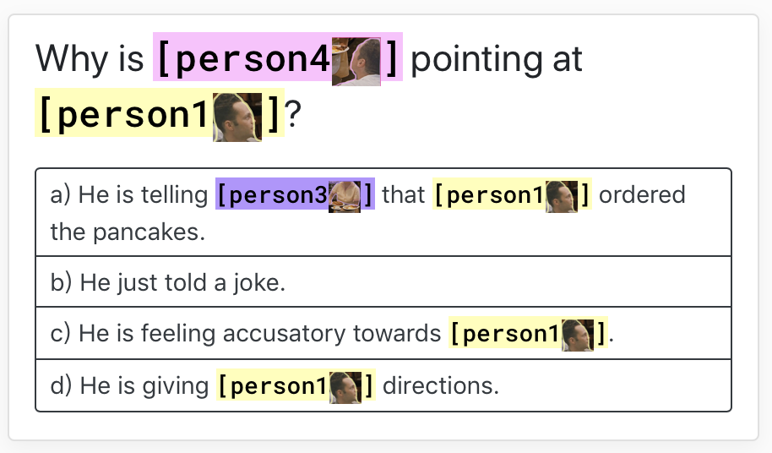
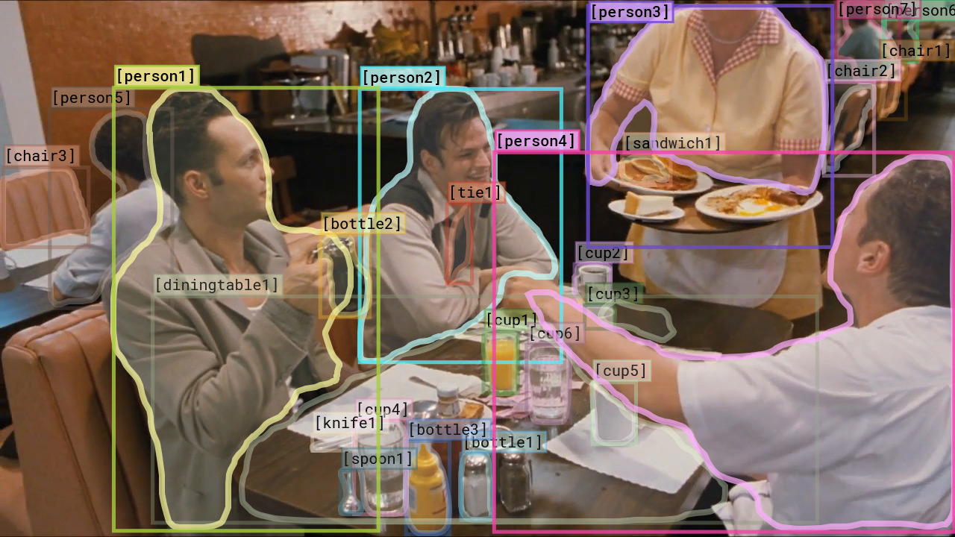
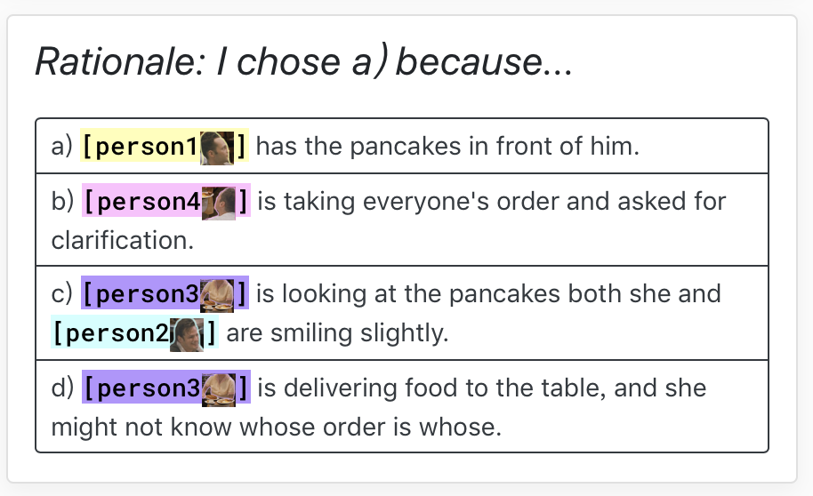
Task Overview

Slide 8
Task Overview
Visual understanding requires not only answering questions correctly, but doing so for the right reasons
Given a question & four answer choices, first select the right answer(Q → A)
If its answer was correct, then it is provided four rationale choices(QA → R)
prediction correct → both the chosen answer and then the chosen rationale correct(Q → AR)
Q → AR
Q → A
QA → R
Notes:
the task is divided into three steps

Slide 9
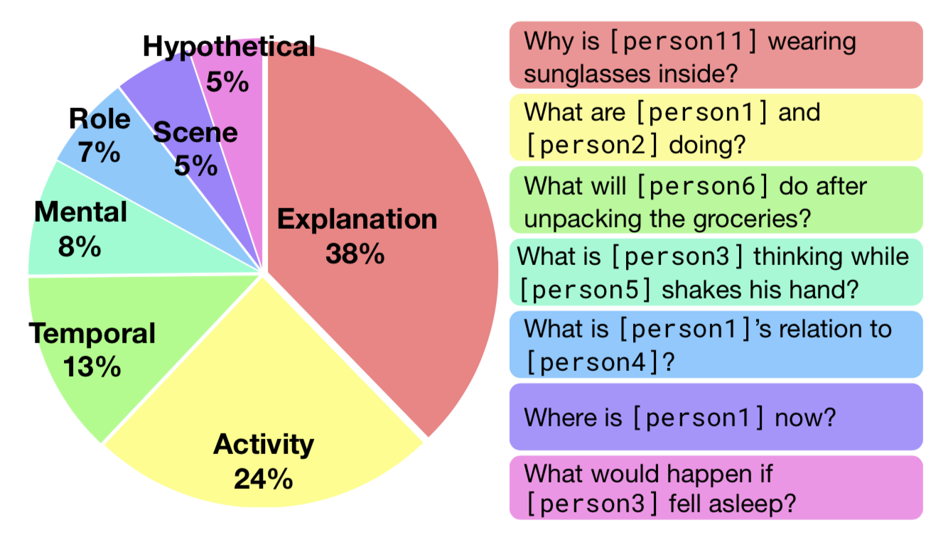
Task Overview
the types of inference
required by questions
in VCR
Notes:
38% of the questions are explanatory ‘why’ or ‘how’ questions,
24% involve cognition-level activities,
and 13% require temporal reasoning (i.e., what might come next)

Slide 10
Task Overview
evaluate models in terms of accuracy and use N=4 responses
Baseline accuracy on each subtask is then 25% (1/N)
What is the baseline accuracy for Q → AR ?
1/16(6.25%)
Q → AR
Q → A
QA → R

Slide 11
Overview
Introduction
Task Overview
VCR Dataset building
Data Collection
Adversarial Matching
Recognition to Cognition Network(R2C)
Results and Analysis

Slide 12
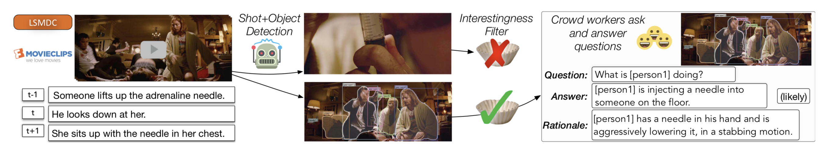
Data Collection
key insight - to carefully select interesting situations
extract still images from movie clips
train and apply an interestingness filter to avoid simple images
Crowdsourcing Quality Annotations
one query and one correct response, and a rationale as well
Notes:
- describe how to collect the questions, correct answers and correct rationales for VCR
- as you can see in the below illustration, the paper first choose a movie clip from a youtube channel
- for the candidate images

Slide 13
Adversarial Matching
Problem: to obtain high-quality incorrect choices at scale
Machine generated
current metrics often prefer incorrect machine-written text over correct human-written text
Human written incorrect answer
expensive
potential subtle label√ ☓ by human
A good counterfactual:
as relevant as possible to the context
cannot be overly similar to the correct response
Notes:
- now we have the correct answer, we'll consider the incorrect ones

Slide 14
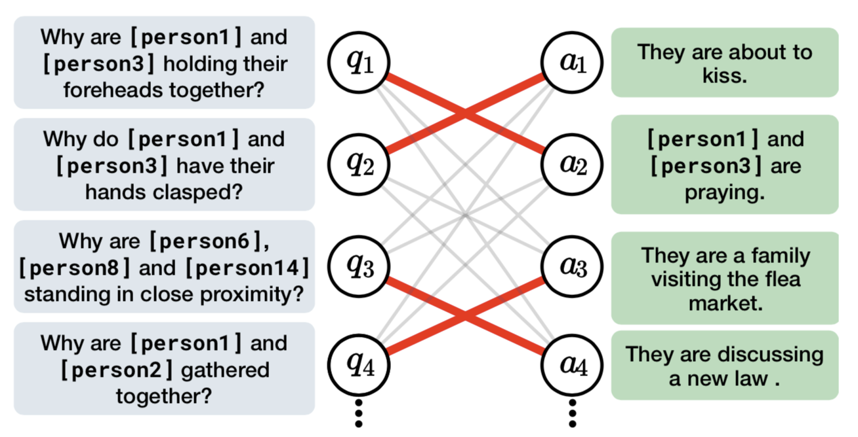
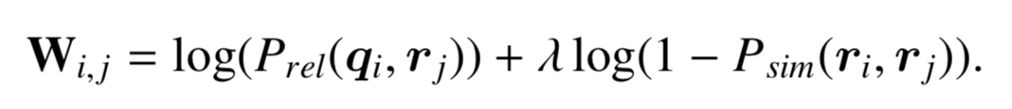
Adversarial Matching
P_{rel} = relevance between a query and a response
P_{sim}= similarity between two response choices
(q_{i}, r_{i}) → correct pair
Notes:
- An algorithm proposed by them to generate incorrect answers
- we assume ···
- match a query with other response as counterfactuals to find the maximum-weight bipartite matching
- hyperparameter namuda to control the tradeoff between similarity and relevance

Slide 15
Adversarial Matching
Drawback?
all correct and incorrect responses and are in templates(lack of diversity)
incorrect responses irrelevant to the asked image(only consider linguistic similarity and relevance)

Slide 16
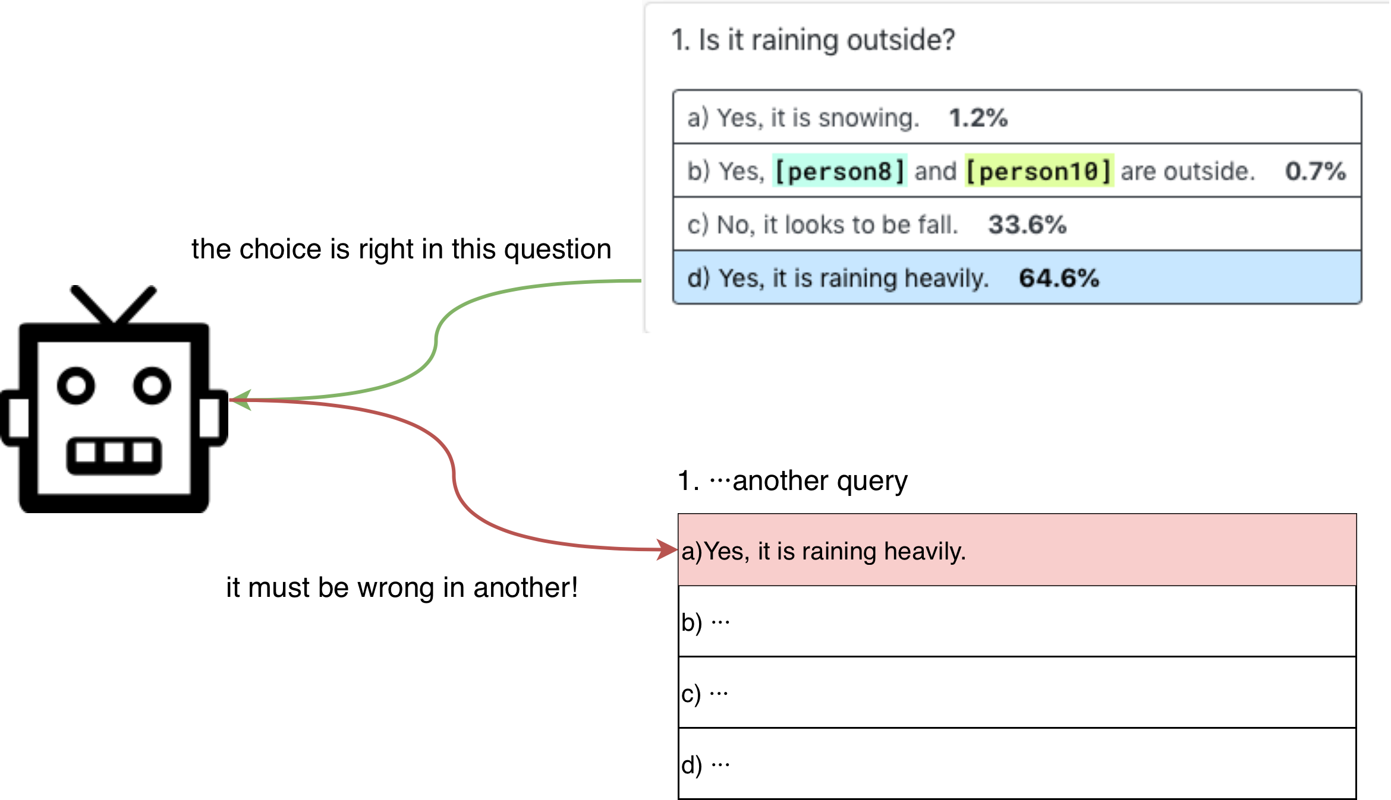
Adversarial Matching
Drawback?

Slide 17
Overview
Introduction
Task Overview
VCR Dataset building
Data Collection
Adversarial Matching
Recognition to Cognition Network(R2C)
Results and Analysis

Slide 18
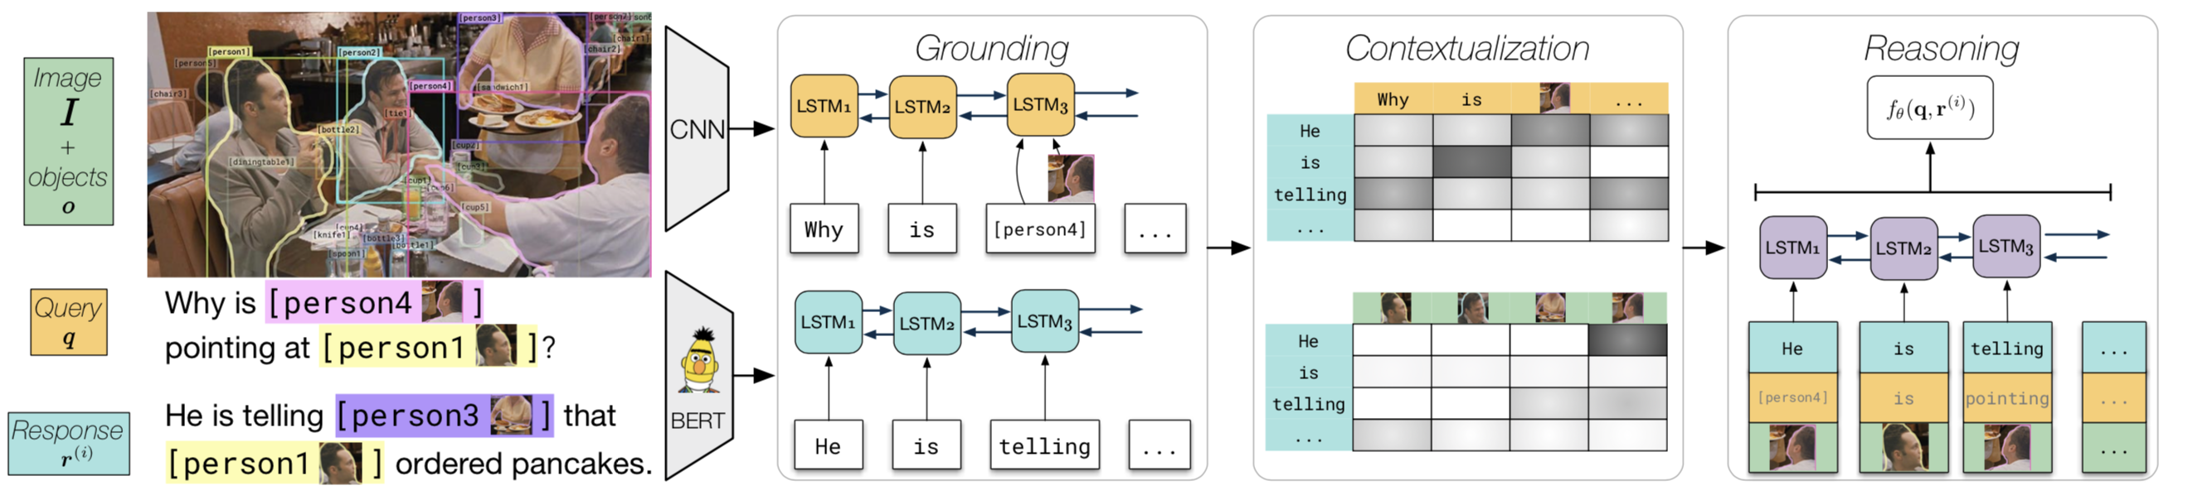
Recognition to Cognition Network(R2C)
a new model for visual commonsense reasoning
Notes:
the challenge of visual commonsense reasoning proposed before is broken into three components:
- grounding the query and response,
- contextualizing the response within the context of query and the entire image,
- and performing additional reasoning steps on top of the rich representations

Slide 19
Recognition to Cognition Network(R2C)
Grounding
learn a joint image-language representation for each token(both text and image object) in a sequence
Notes:
which involves referring to the image for the two people

Slide 20
Recognition to Cognition Network(R2C)
Grounding
at each position is passed as input a word representation for w_{i}, as well as visual features for o_{wi}(if it’s a word, o_{wi} points to the whole image)

Slide 21
Recognition to Cognition Network(R2C)
Contextualization
Given a grounded representation of the query and response, to contextualize these sentences(query & response, image objects & response)
Notes:
using attention mechanisms
- includes resolving the referent ‘he,’ and why one might be pointing in a diner

Slide 22
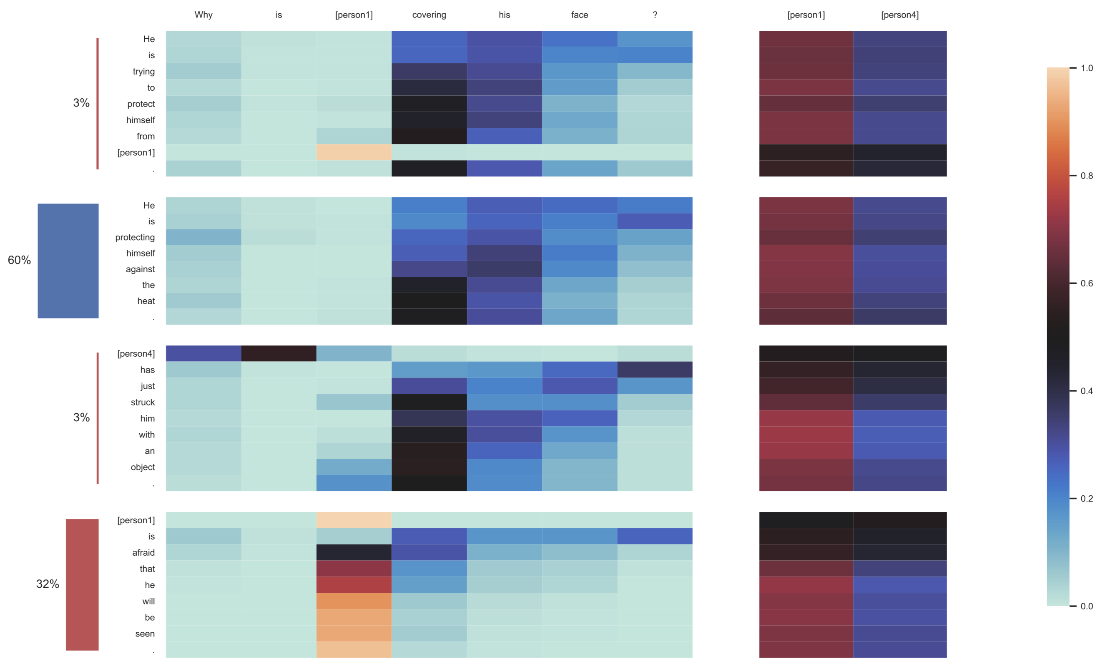

Slide 23
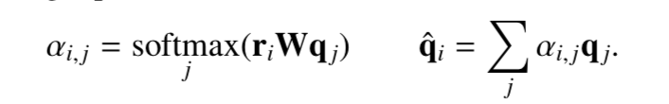
Recognition to Cognition Network(R2C)
Contextualization
For each position i in the response, we will define the attended query representation as q_{i}ˆ using the following equation:
perform another bilinear attention between the response r and each object o’s image features (the attention be o_{i}ˆ)

Slide 24
Recognition to Cognition Network(R2C)
Reasoning
allow the model to reason over the response, attended query and image objects
Notes:
determine the social dynamics between [person1] and [person4]
using a bidirectional LSTM that is given as context qi , ri , and oi for each position i

Slide 25
Overview
Introduction
Task Overview
VCR Dataset building
Data Collection
Adversarial Matching
Recognition to Cognition Network(R2C)
Results and Analysis

Slide 26
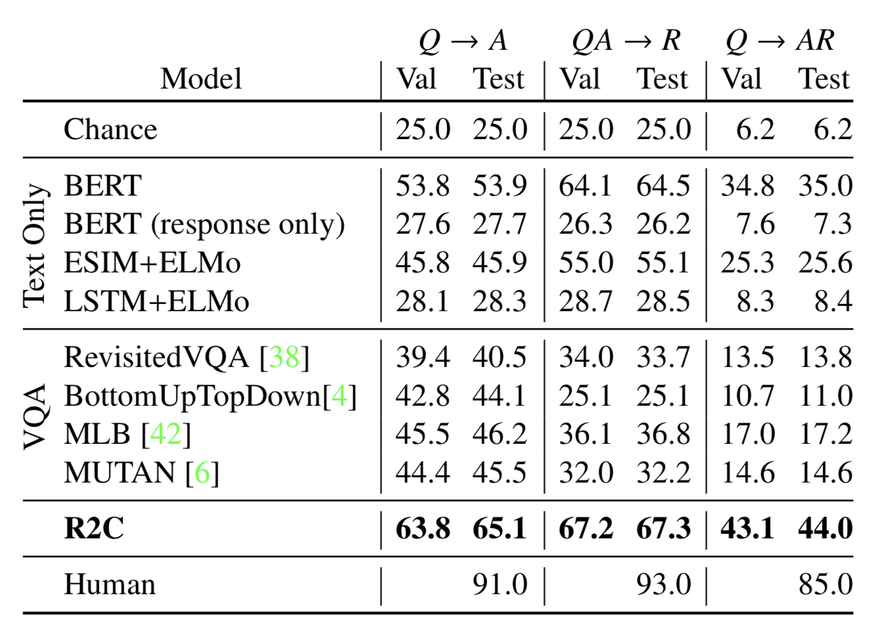
Results and Analysis
Accuracy
VQA models struggle on both (Q → A) and (Q → AR)
Bert performs better than VQA models without image information
Notes:
- Visual Question Answering was one of the first large-scale datasets that framed visual understanding as a QA task
- One possible reason is that VQA model are often built around multilabel classification, so they can hardly handle the reasoning task
- another interesting result is that
- it just like Bert is good at doing reading comprehension without reading

Slide 27
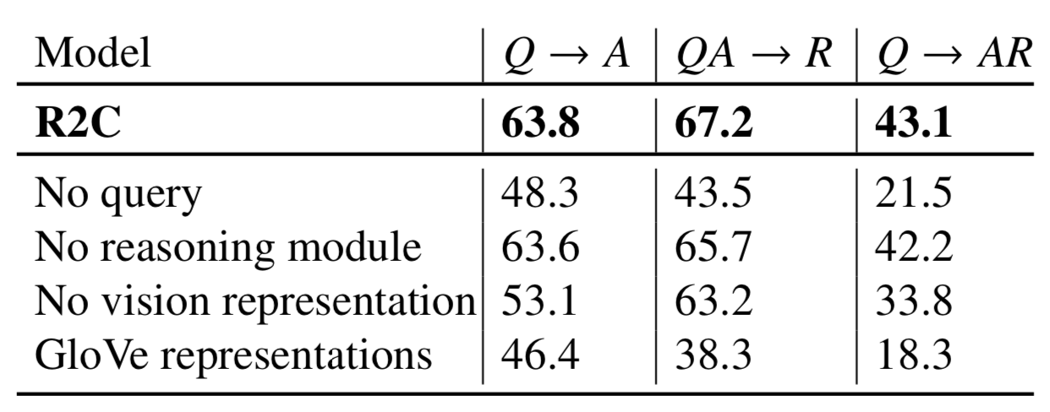
Results and Analysis
Removing query representation
drop of 21.6%
Removing reasoning module
slightly lower by 1.9%
Removing vision representation
worse than text-only Bert
Using GloVe representation
a loss of 24%
Ablation
Notes:
they evaluated the model under several ablations to determine which components are most important
- Removing the query representation (and query-response contextualization entirely) results in a drop of 21.6% accuracy points in terms of Q → AR performance
Taking the reasoning module lowers performance by 1.9%, which suggests that it is beneficial, but not critical for performance.
The model suffers most when using GloVe representations instead of BERT: a loss of 24%. This suggests that strong textual representations are crucial to VCR performance

Slide 28
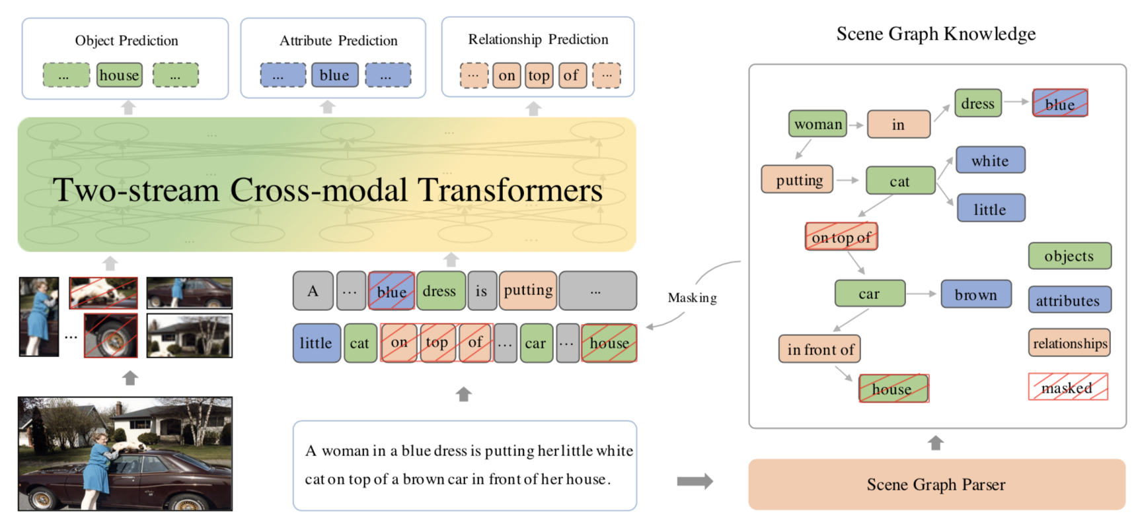
Other
ERNIE-ViL
Scene graph
Notes:
The scene graph contains structured knowledge of visual scenes, include the present objects, attributes of objects, and relationships between objects

Slide 29
Thank you!

